Slide 1
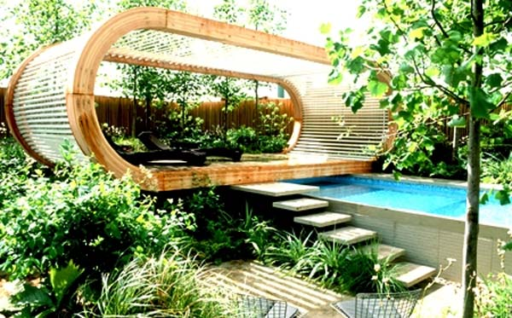
MY Future
Jakub Rusnák
9.S
Bellamos

Slide 2
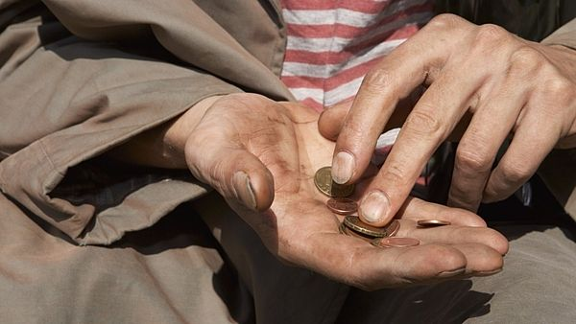
1.
introduction

Slide 3
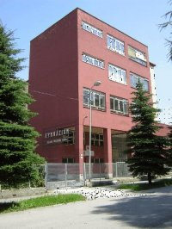
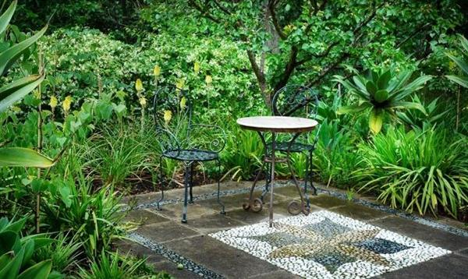
2.
Professional goals
a)Secondary school
b)University
c)Job

Slide 4
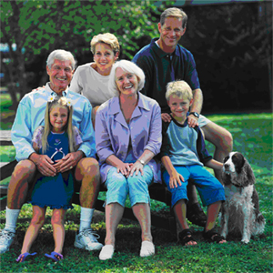
3.
Personal goals
a)Family

Slide 5
4.
Conclusion

